Slide 1


Iteration 2
Team 1
Masih Vahida, Robin Roeoesli, Jordyn Lipsey, Deasia Little, Ardit Briskaj

Slide 2
Agenda
1
Frontend
2
Backend
3
Database
4
SocketIO
5
PassportJS
6
Testing
7
Next Iteration

Slide 3

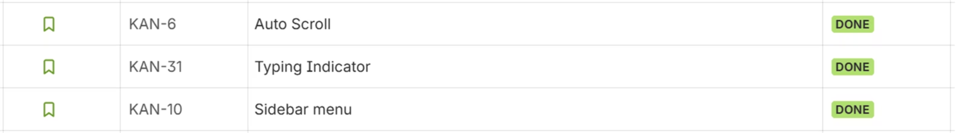
Frontend Evolution
Progress during Iteration 1
During the first iteration, our focus was on establishing the core visual and interactive elements of the application. We laid the groundwork for a responsive and intuitive user experience.

Slide 4
Frontend Components
Key Components in the Frontend Layer
1
2
3
Message Display
Message Container
Sidebar Navigation
Handles text sent or received by the user, ensuring clear and efficient communication flow.
Organizes and displays messages from various users within a single, coherent interface.
Enables seamless switching between community and AI chat interfaces for diverse interactions.
4
5
User Login & History
Message Input
Manages user authentication and retrieves past chat history for a personalized experience.
Provides a dedicated area for users to compose and review messages before submission.

Slide 5

Frontend Technology Upgrade
Migration to Material UI
We switched from plain HTML + CSS to Material UI. This migration has streamlined our development process and modernized the application's appearance.
We also implemented a global theme, ensuring a consistent visual identity across the entire application.
All components now seamlessly integrate Material UI, leading to improved consistency and a significantly better user experience for our users.

Slide 6
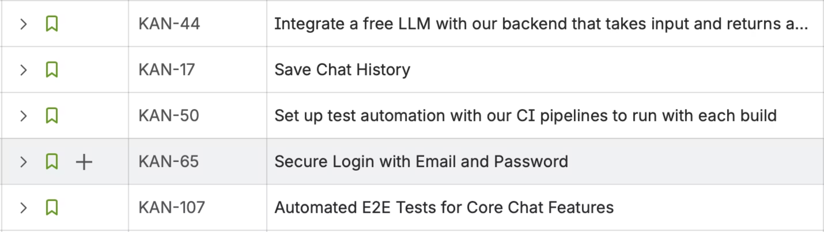
Backend Development
Significant Progress during Iteration 2
Iteration 2 saw substantial progress in solidifying our backend infrastructure. We focused on building robust and scalable services to support the frontend functionalities.

Slide 7




Backend Architecture Overview
Our backend architecture is designed for scalability and real-time communication, ensuring a seamless user experience across the application.
NestJS API
Manages requests for authentication, chat messages, reactions, and historical data, serving as the central hub for all backend operations.
PostgreSQL Database
Utilizes AWS RDS for production and local Docker for development, ensuring data persistence and reliability.
TypeORM Integration
Facilitates ORM mapping to entities: Account, Message, Reaction, and UserMessagesReceived, streamlining data management.
WebSocket (AppSocketGateway)
Enables real-time chat messaging through events like "send-chat-message", "user-typing", and "receive-existing-messages".

Slide 8






Core Backend Logic
Our backend services are meticulously designed to handle critical functionalities, from user authentication to real-time message handling.
AuthService
Handles secure user login and registration using bcrypt for password hashing and JWT for authentication.
AccountService
Manages user data, ensuring unique usernames and efficient retrieval of account information.
MessageService
Responsible for saving chat messages and accurately linking senders to recipients within the database.
AppSocketGateway
Orchestrates real-time communication via WebSockets, ensuring instant message delivery and updates.
AI Model Integration
Utilizes Groq/Compound-Mini for intelligent chat responses and natural language processing capabilities.

Slide 9
Backend Code Snippets
Illustrating the practical implementation of our backend logic:
Authentication Service
App Socket Gateway
api/authentication/service.ts
api/app-socket/app-scoket.gatweay.ts
login(user: Account) { const payload = { sub: user.username, fullname: user.fullname }; const secret = process.env.JWT_SECRET!; const accessToken = jwt.sign(payload, secret, { expiresIn: '1h' }); return { accessToken, user: { username: user.username, fullname: user.fullname } };}
@SubscribeMessage('send-chat-message')handleSendMessage(socket: Socket, payload: any) { this.messageService .insertMessage((socket as any).username, payload) .then((message) => { socket.broadcast.emit('recieve-chat-message', { data: [(socket as any).username, payload, message.id], }); socket.emit('recieve-chat-message', { data: ['You', payload, message.id], }); for (const user of this.onlineUsers) { if (user.username !== (socket as any).username) { this.userMessagesReceivedService .insertUserMessagesReceived(user.username, message.id) .then((message) => {}); } } });}
Message Service
api/services/message.service.ts
async insertMessage(message_owner: string, message_content: string) { const message = this.messageRepository.create({ message_owner: message_owner, message_content: message_content, created_at: new Date(), }); return this.messageRepository.save(message);}

Slide 10

Automated Testing Integration
Our CI/CD pipeline ensures continuous quality control, automating critical steps from build to deployment and issue tracking.
CI/CD Workflow
Automatically builds Docker containers for both API and UI, initiating the testing process seamlessly.
Playwright E2E Tests
Executed in GitHub Actions to verify critical functionalities, including user authentication and real-time messaging.
Metric Uploads
Uploads key metrics such as Lines of Code (LOC), complexity, and function counts for comprehensive analysis.
GitHub Issue Creation
Automates the creation of GitHub Issues for failed tests, facilitating prompt resolution and defect tracking.

Slide 11
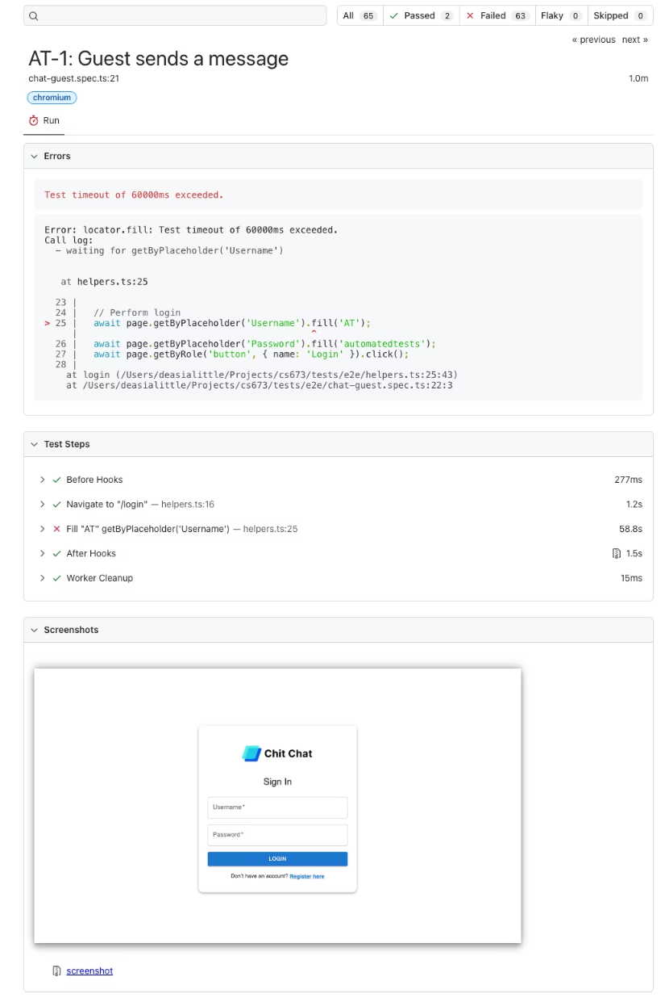
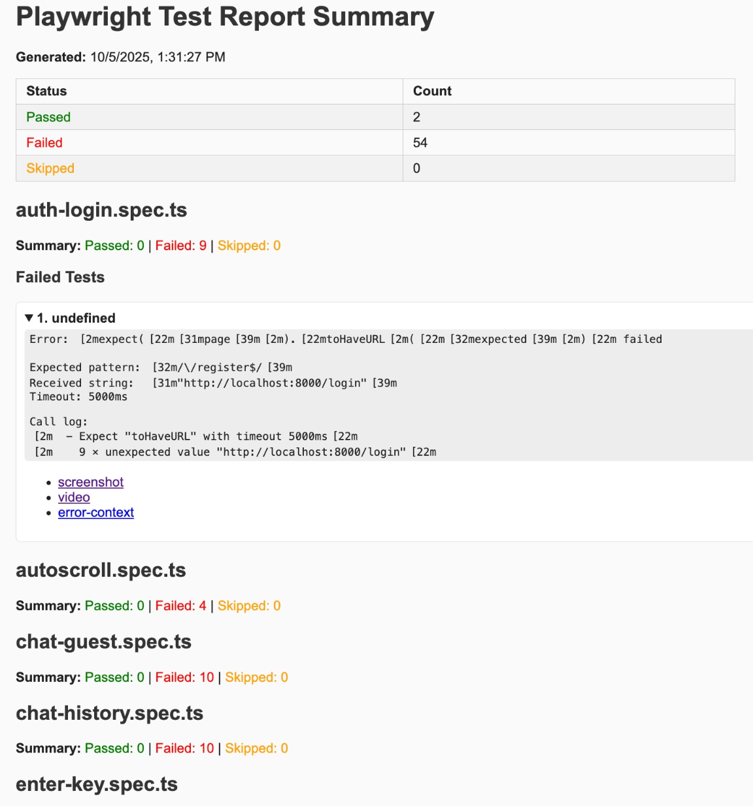
Automated Testing Reports
Detailed reports provide insights into test execution and code quality, empowering informed decision-making and continuous improvement.
This report highlights the passing and failing tests, offering an immediate overview of the system's health.
This detailed summary provides a breakdown of test coverage, execution times, and any identified performance bottlenecks.

Slide 12



QA Metrics
count-loc.sh
count-functions.sh
eslint-report.sh
Lines of Code
Function count
Cyclomatic complexity

Slide 13
Defects & Challenges
Broken Selectors
Dynamic Elements
Timing Issues in Docker
After UI redesign, impacted all Playwright tests.
Prevented stable automation during testing.
Authentication and WebSocket timing problems.
Configuration Issues Fixed
Missing Error Handling
Resolved JWT secret and environment variable problems.
E.g., lack of checks for duplicate usernames.

Slide 14
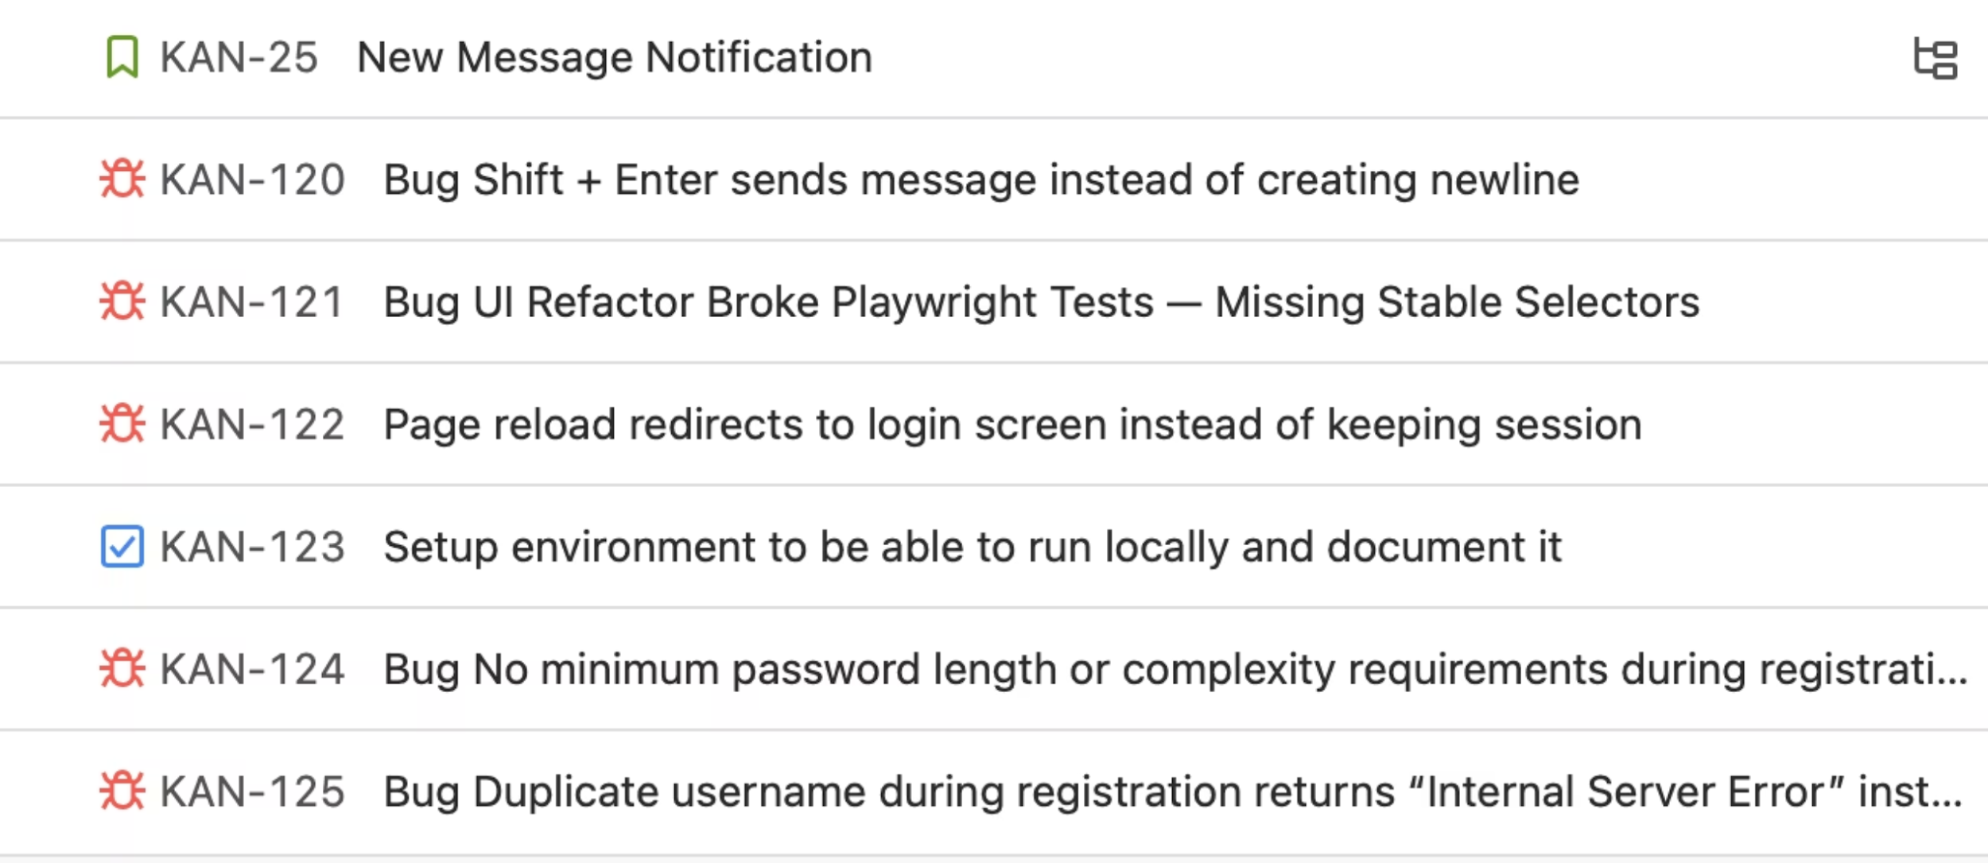
Next Steps
Plans for Iteration 3
Iteration 3 will be dedicated to fixing bugs and finalizing the core features of the Chit Chat app.

